Slide 1

Manipulating the DOM
Web Development I

Slide 2

What is the “DOM”?
Abbreviation for the Document Object Model
Each web page is a “document”
The DOM is an in memory, tree structure representation, of that document (or web page)
Enables the HTML structure to be easily accessed by programming languages
The browser itself uses it to apply styling and other information to the correct elements as it renders a page
Developers like you can manipulate the DOM with JavaScript AFTER the page has been rendered.

Slide 3
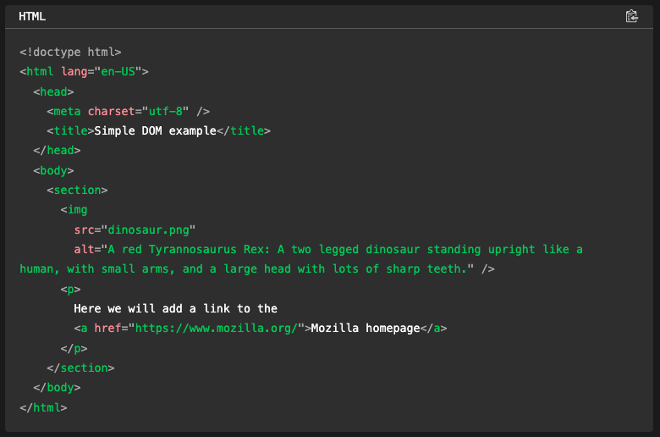
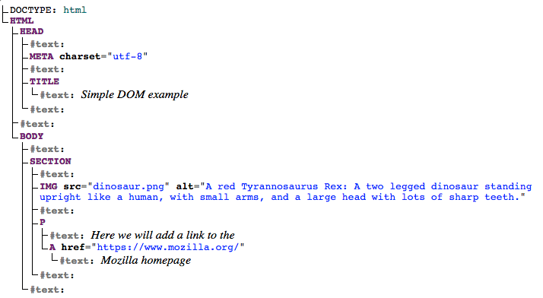
⬅ The HTML
The DOM ➔

Slide 4
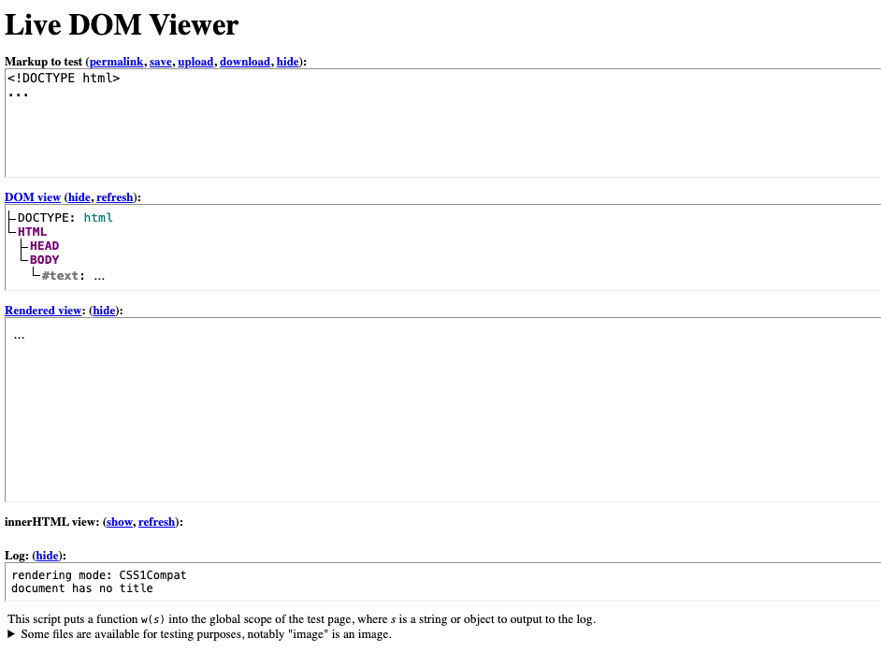
https://software.hixie.ch/utilities/js/live-dom-viewer/

Slide 5
Each entry in the tree is called a node.
The diagram shows that some nodes represent elements (identified as HTML, HEAD, META and so on) and others represent text (identified as #text).
There are other types of nodes as well, but these are the main ones you'll encounter.

Slide 6
Nodes are also referred to by their position in the tree relative to other nodes:
Root node: The top node in the tree, which in the case of HTML is always the HTML node (other markup vocabularies like SVG and custom XML will have different root elements).
Child node: A node directly inside another node. For example, IMG is a child of SECTION in the example.

Slide 7
Descendant node: A node anywhere inside another node. For example, IMG is a child of SECTION in the example, and it is also a descendant. IMG is not a child of BODY, as it is two levels below it in the tree, but it is a descendant of BODY.
Parent node: A node which has another node inside it. For example, BODY is the parent node of SECTION in the example.
Sibling nodes: Nodes that sit on the same level in the DOM tree. For example, IMG and P are siblings in the example.

Slide 8

Top Tip
It is useful to familiarize yourself with this terminology before working with the DOM, as a number of the code terms you'll come across make use of them.
You may have also come across them if you have studied CSS (e.g. descendant selector, child selector).

Slide 9
Nodes and Elements
The DOM HAS MANY Nodes, everything is a Node.
An Element IS A Node

Slide 10

Confusingly
Element ATTRIBUTES are also Nodes but
Attr objects inherit the Node interface, but since they are not actually child nodes of the element they describe, the DOM does not consider them part of the document tree.
Thus, the Node attributes parentNode, previousSibling, and nextSibling have a null value for Attr objects.
https://www.w3.org/TR/2004/REC-DOM-Level-3-Core-20040407/core.html#ID-637646024

Slide 11

But……
For now, just remember that:
The DOM is made up of Elements
These Elements are Nodes in a Tree
If you want to dig deeper:
https://www.w3.org/TR/2004/REC-DOM-Level-3-Core-20040407/core.html#ID-637646024
https://dom.spec.whatwg.org/#introduction-to-the-dom
https://medium.com/front-end-weekly/what-is-the-difference-between-element-and-node-in-dom-56182fce7af1.
https://developer.mozilla.org/en-US/docs/Web/API/Document_Object_Model/Introduction#fundamental_data_types

Slide 12
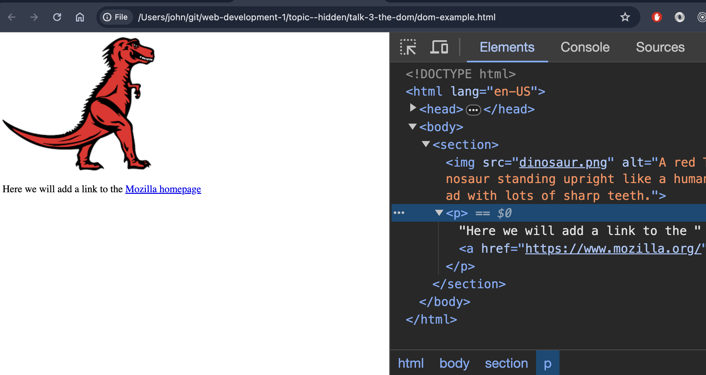

Slide 13
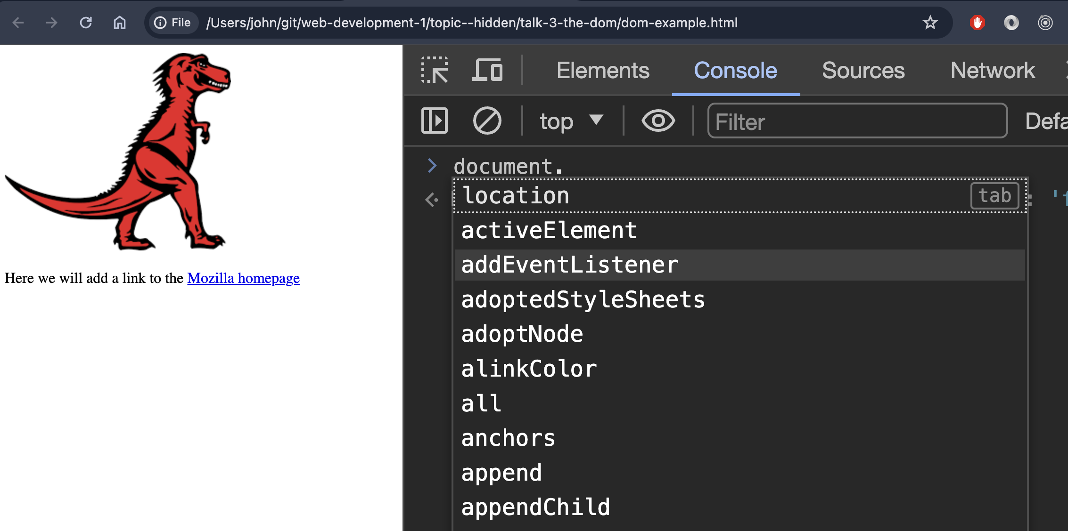
The DOM is available via the “document” constant
The “document” constant is available anywhere when running a script in the browser
It is available in the “Global Scope”

Slide 14
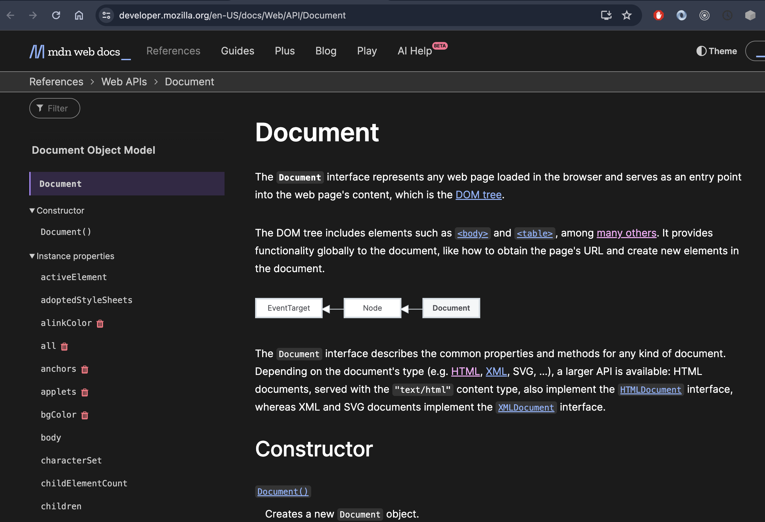
https://developer.mozilla.org/en-US/docs/Web/API/Document

Slide 15
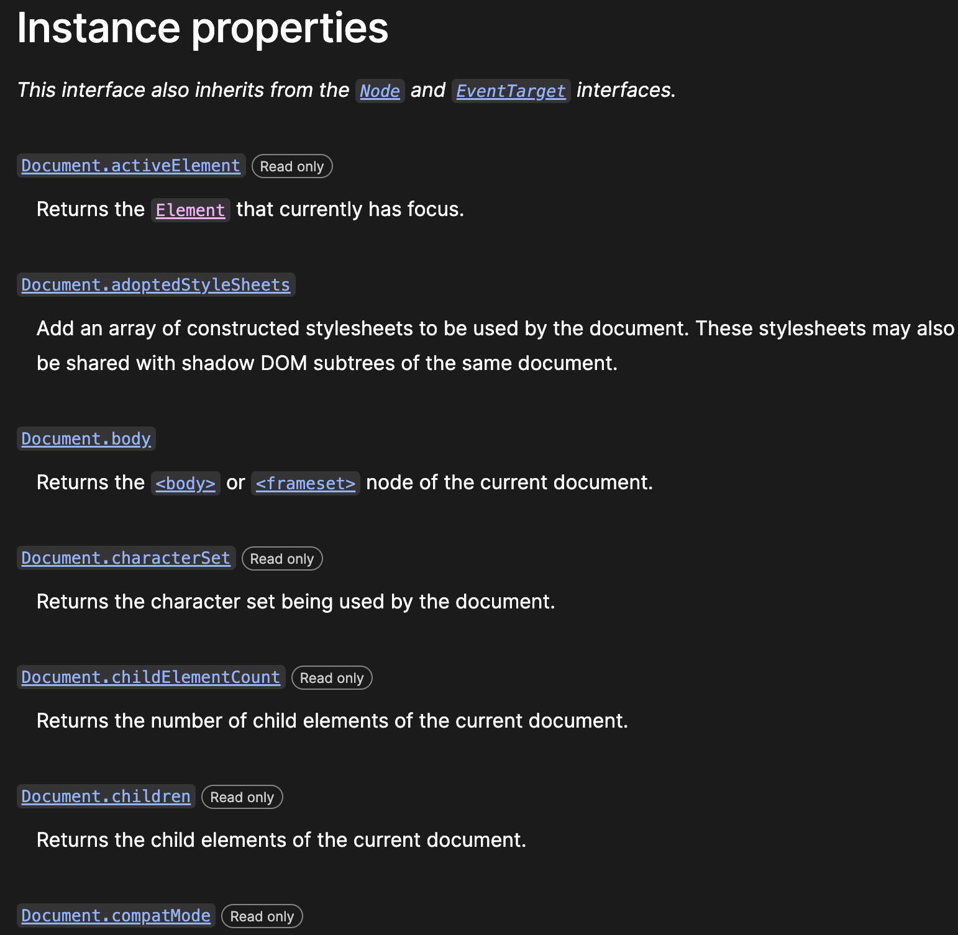
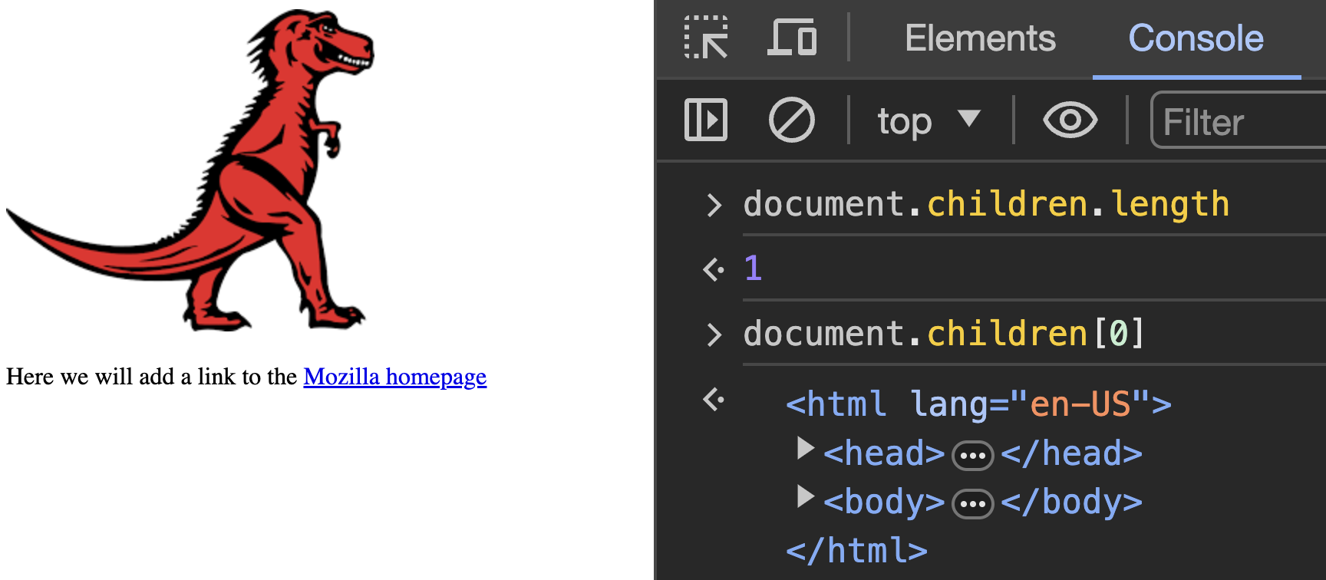
https://developer.mozilla.org/en-US/docs/Web/API/Document

Slide 16
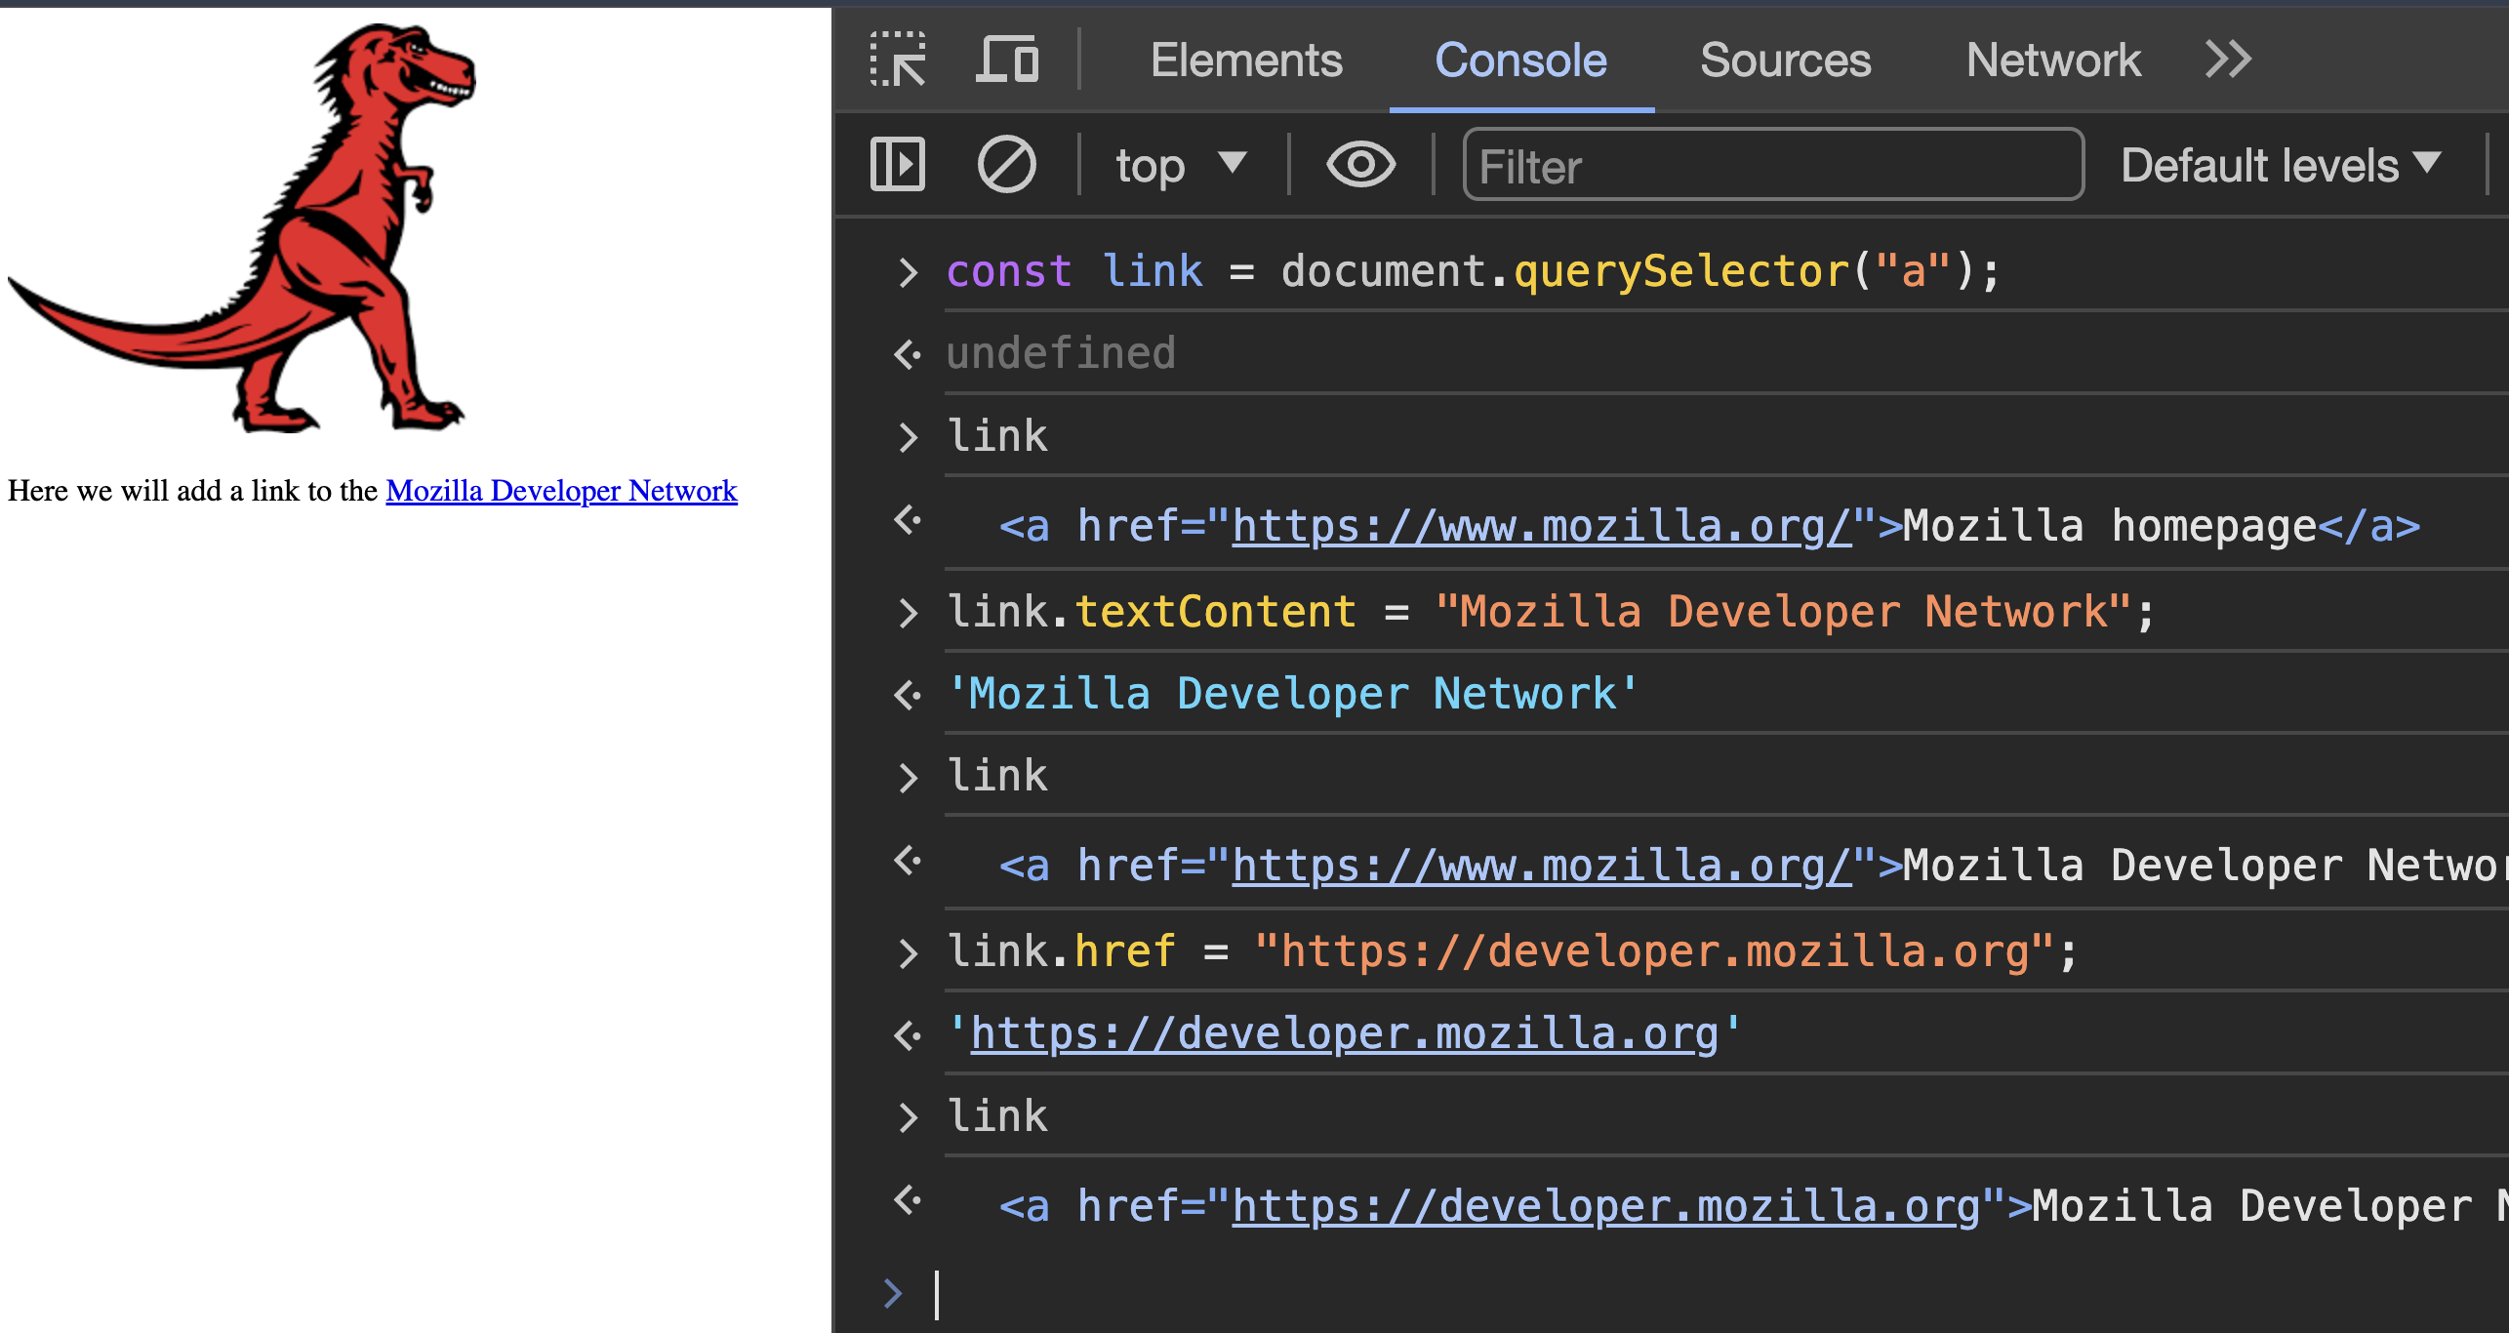

Slide 17
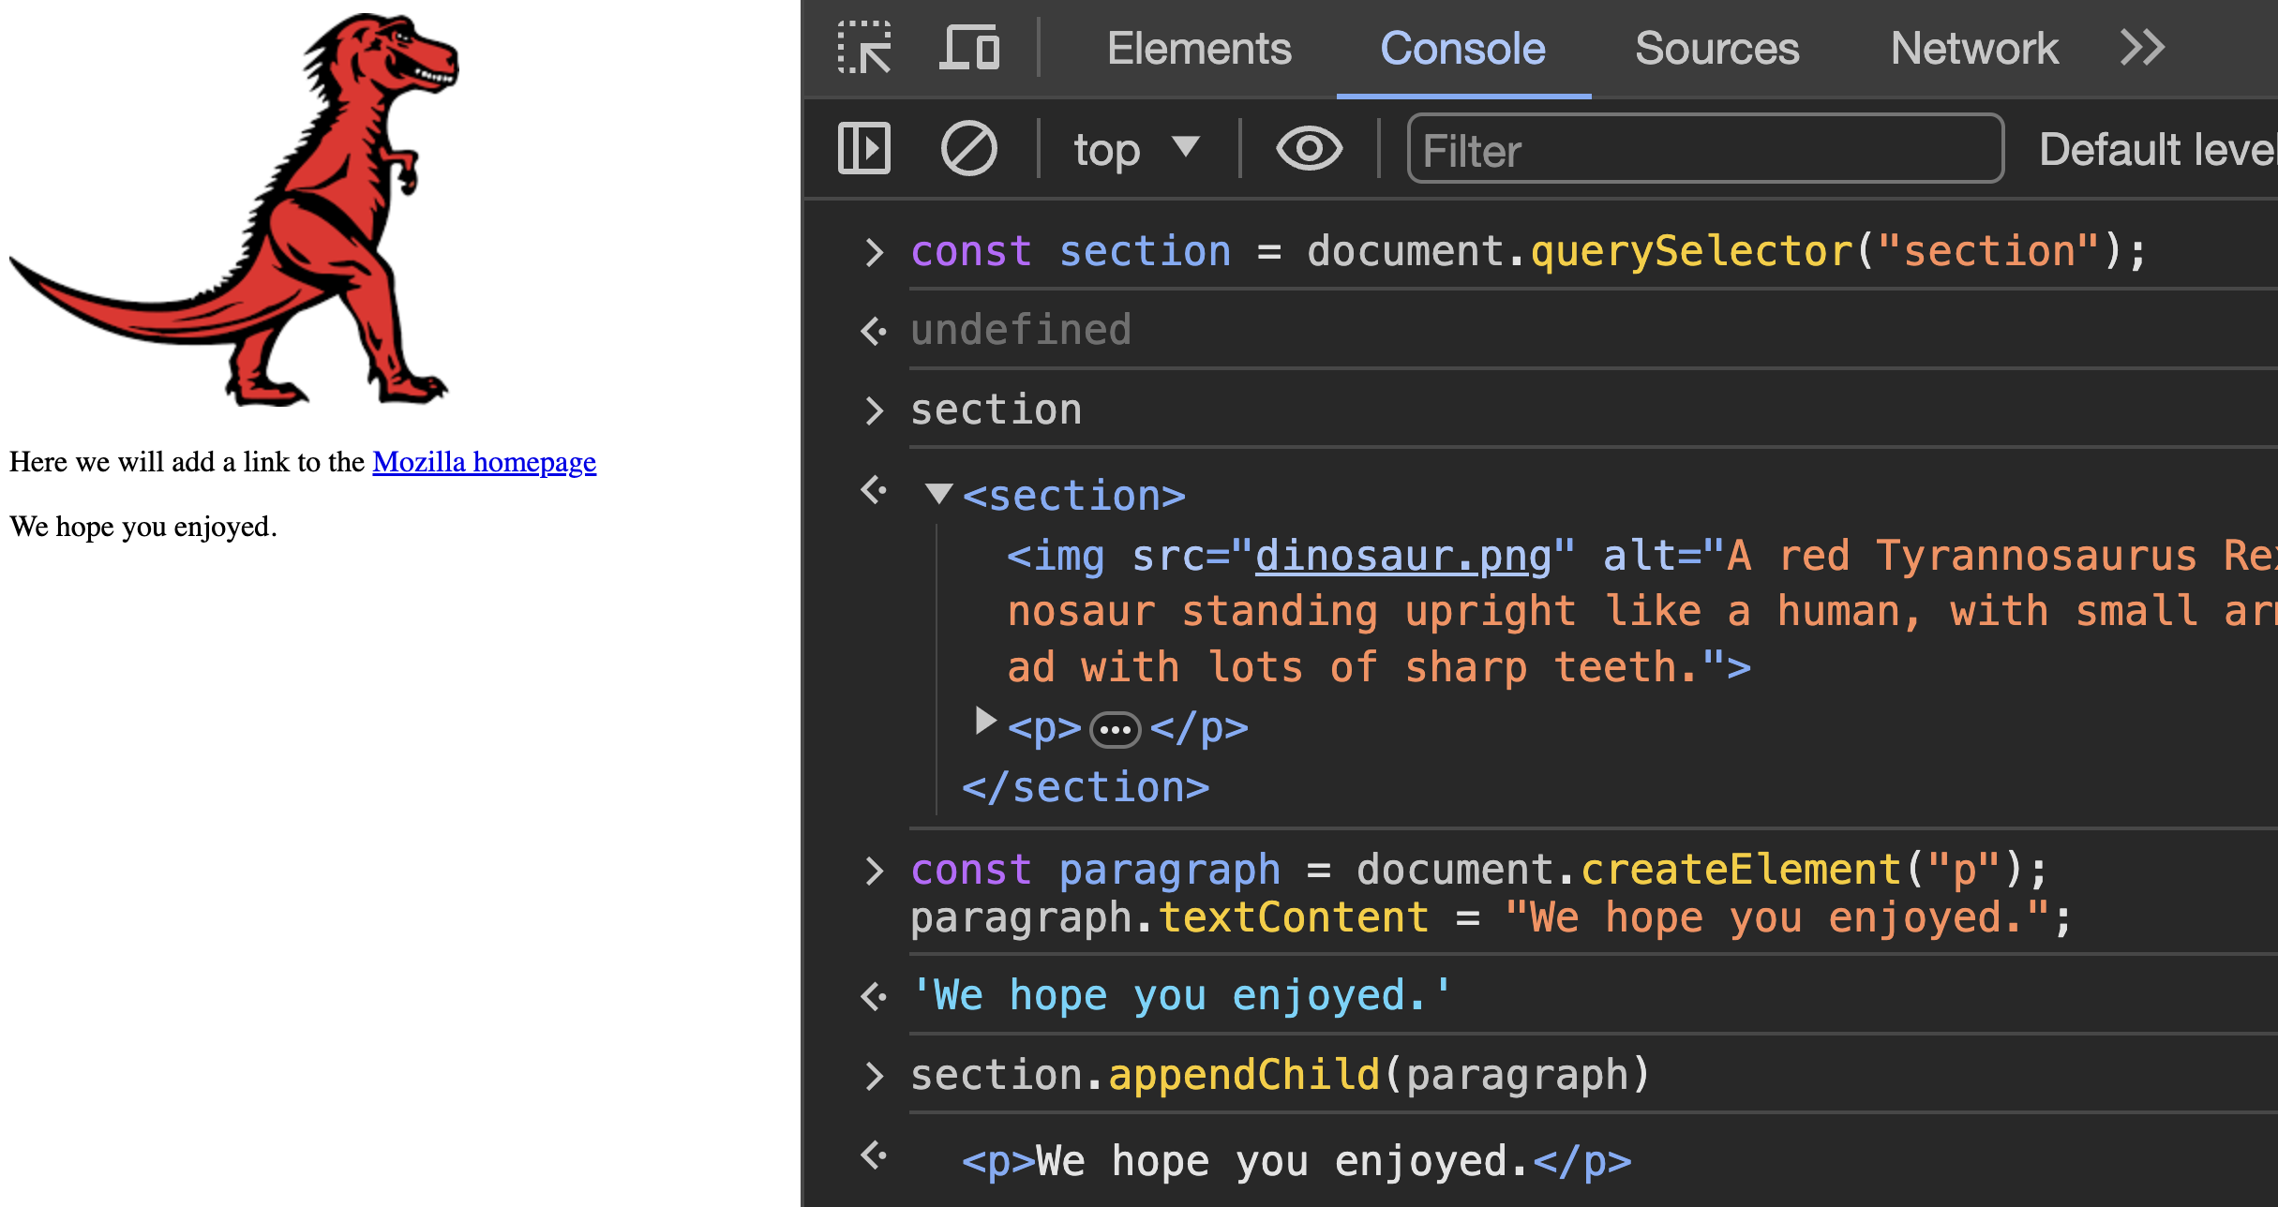
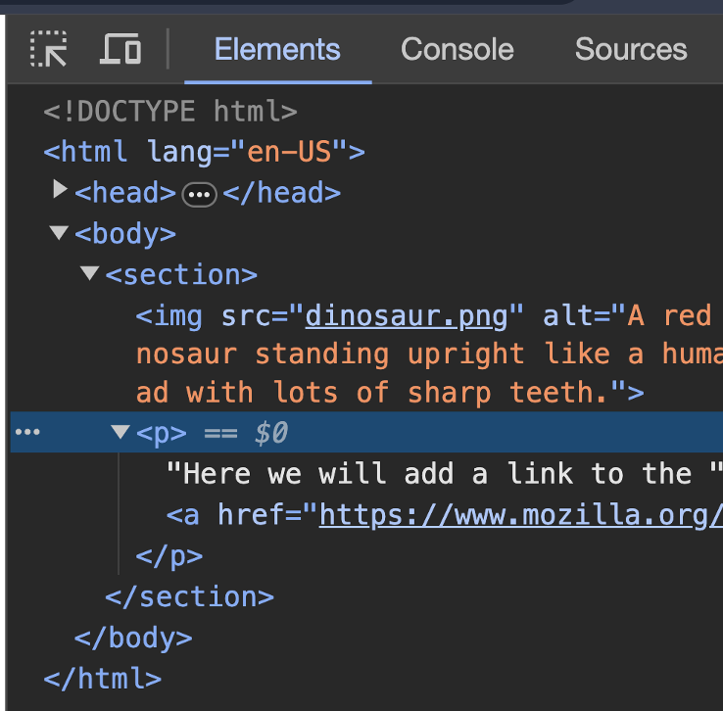

Slide 18
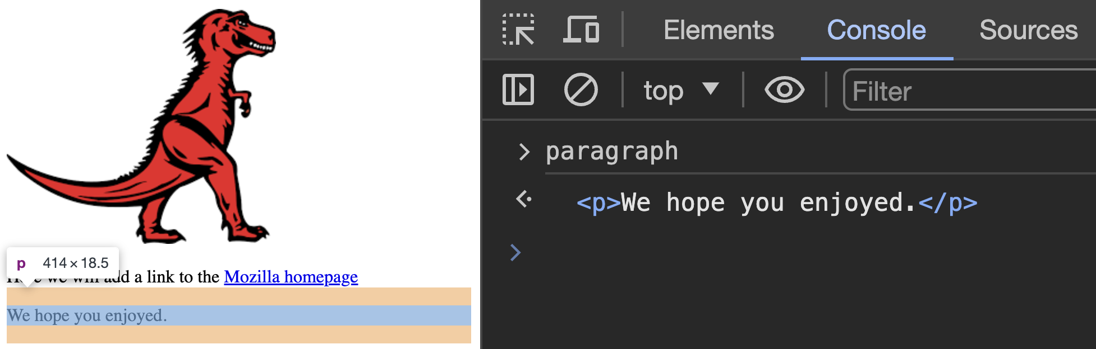
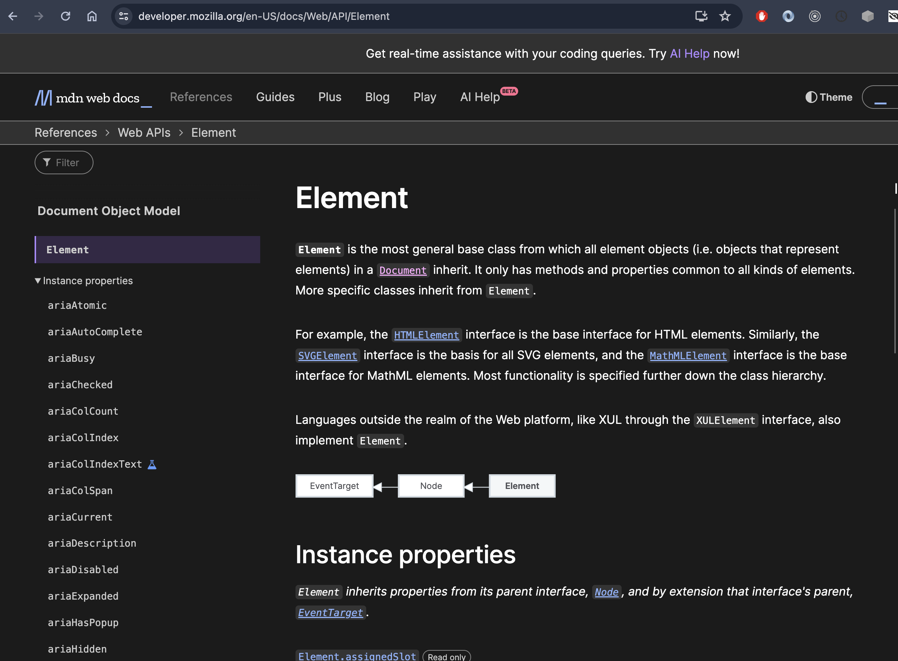
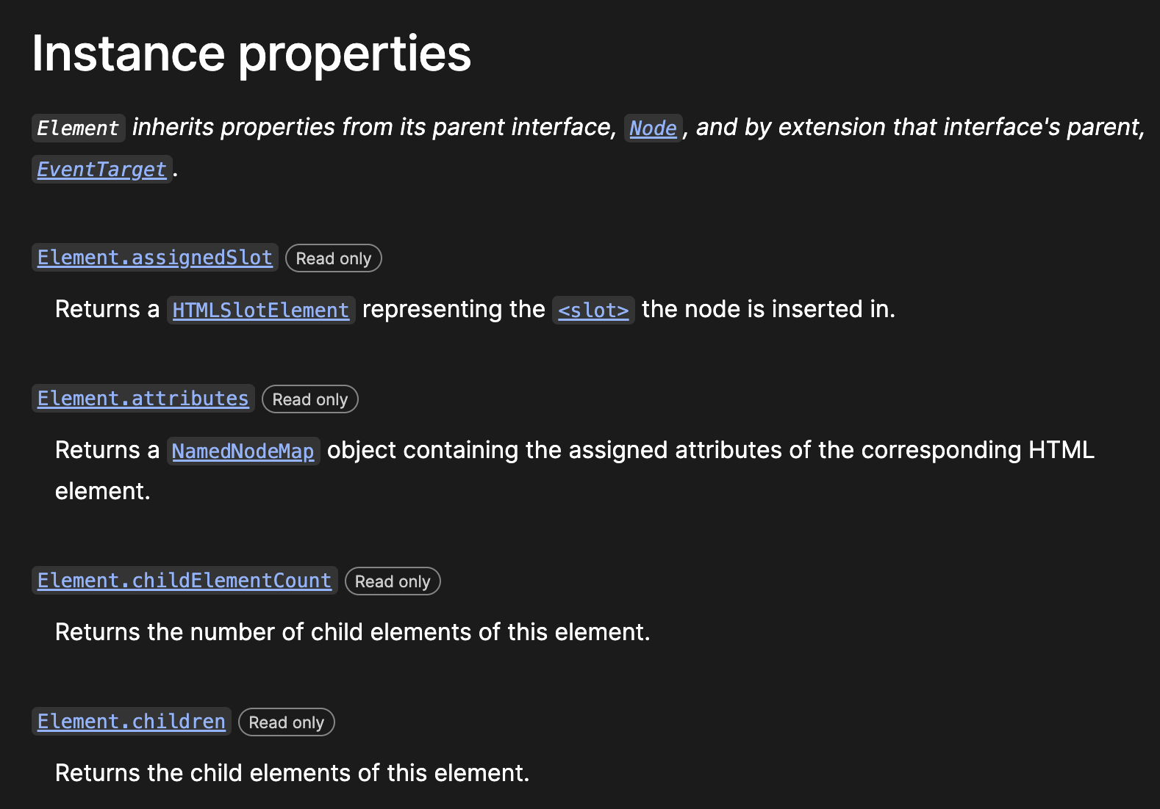
Element

Slide 19
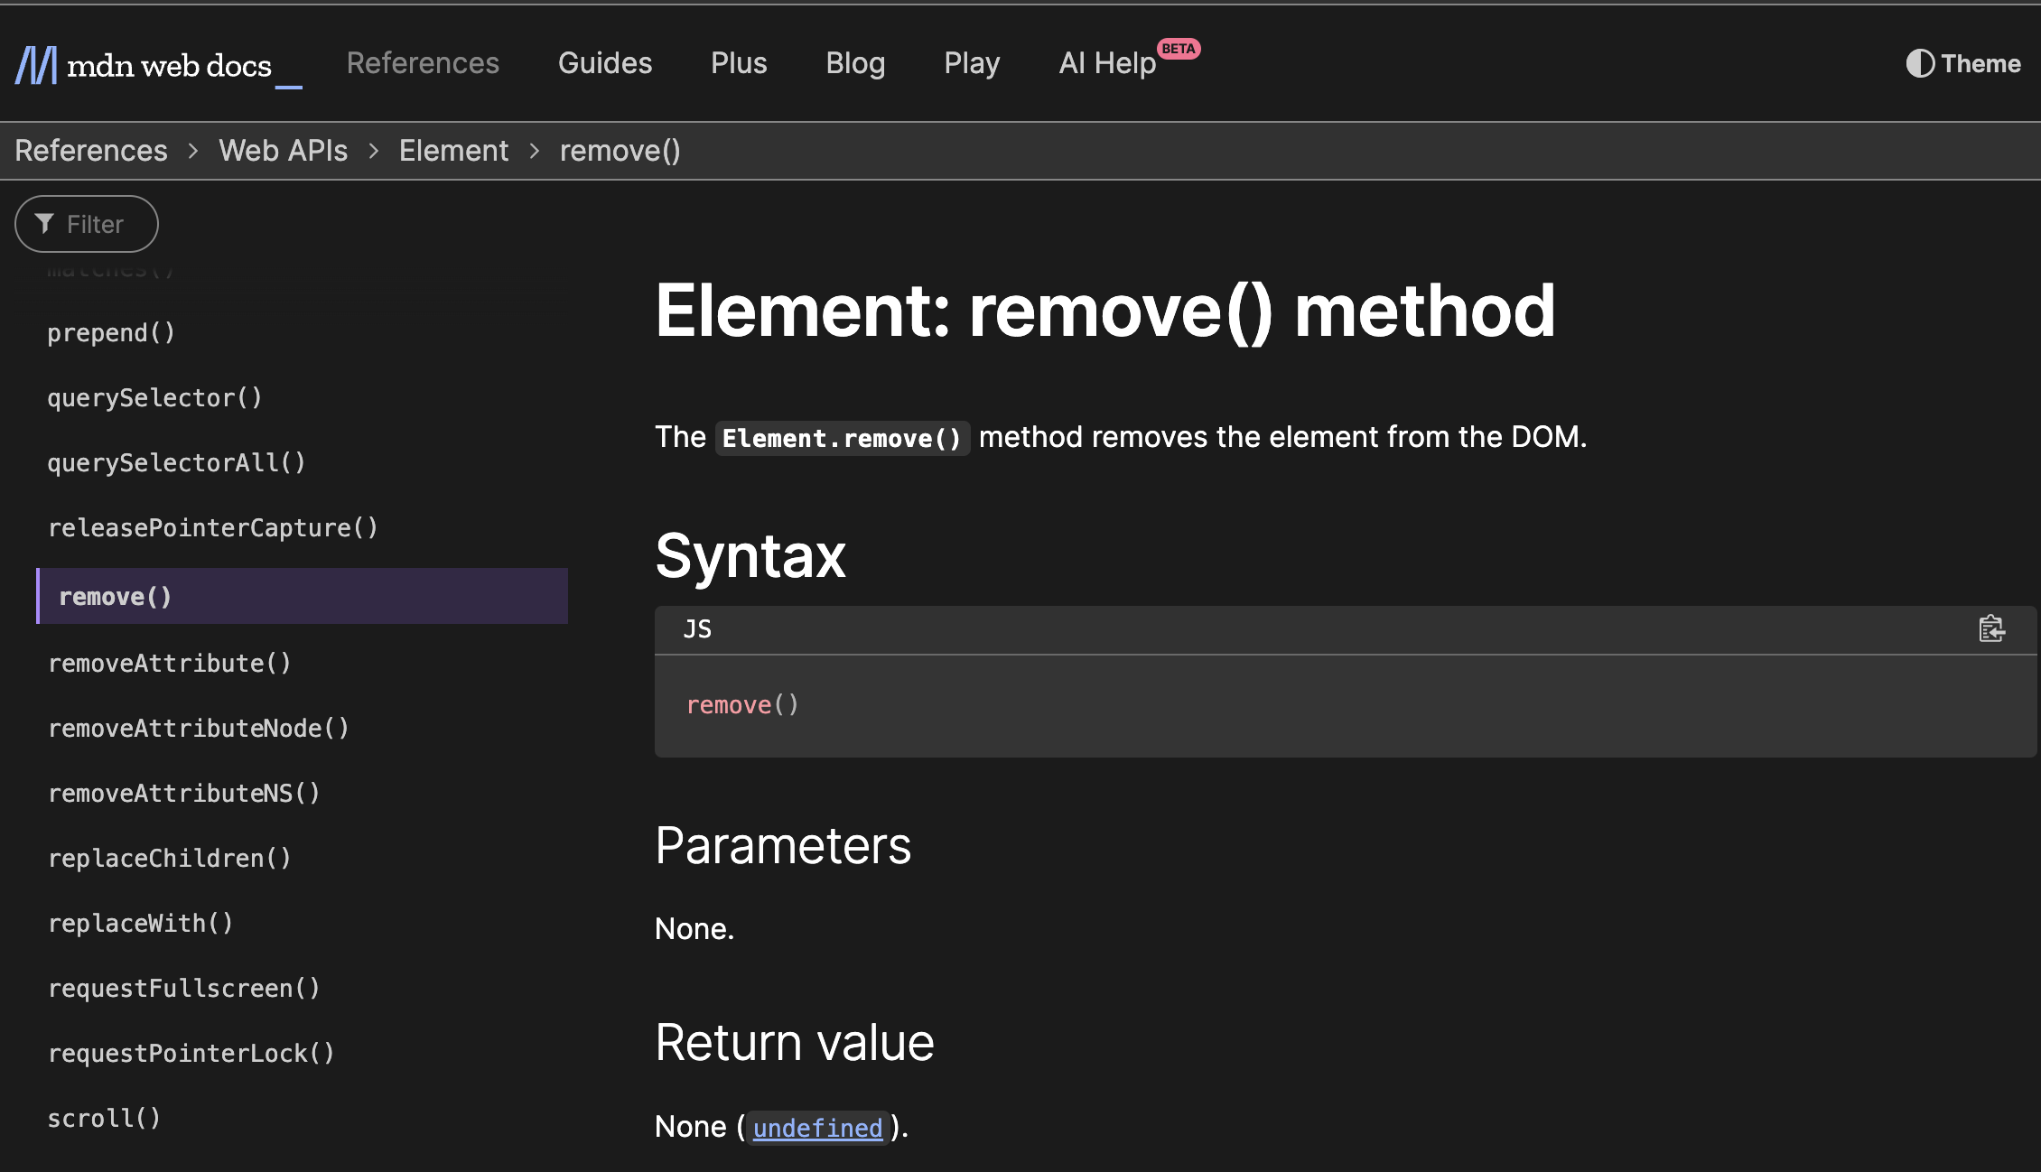
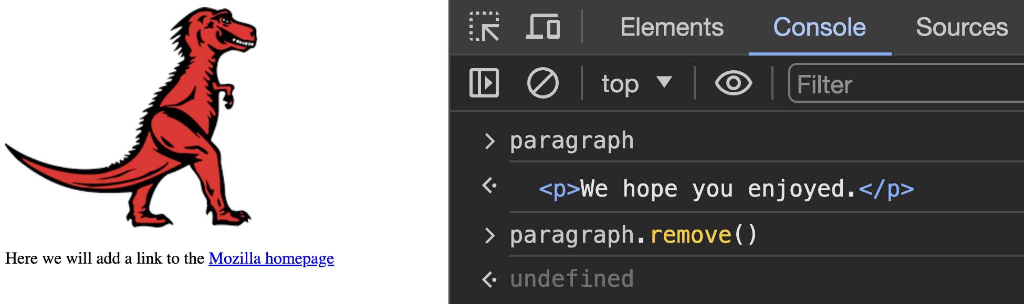
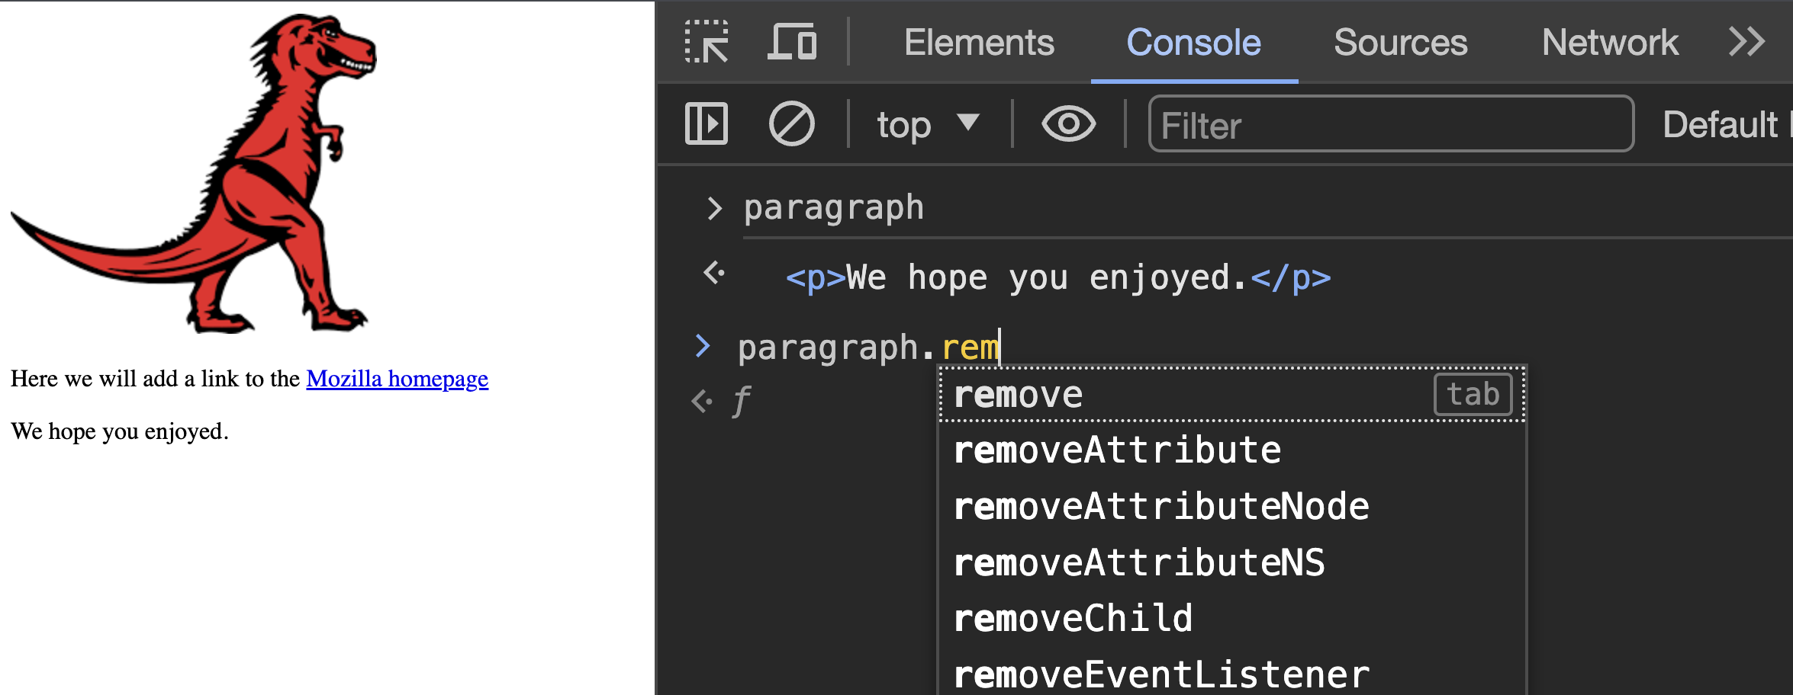

Slide 20
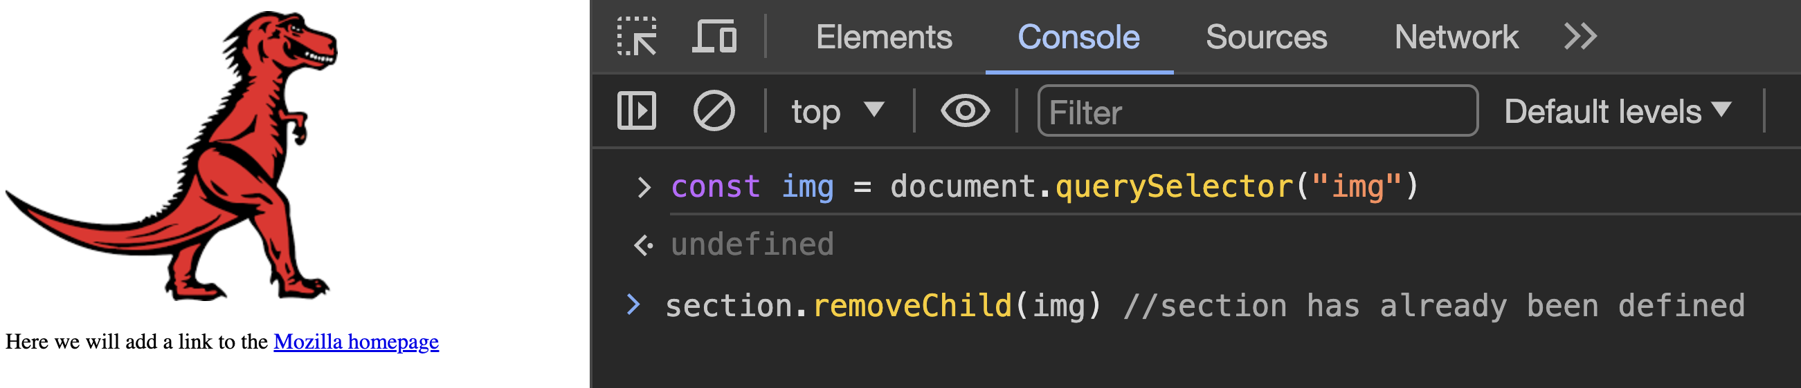
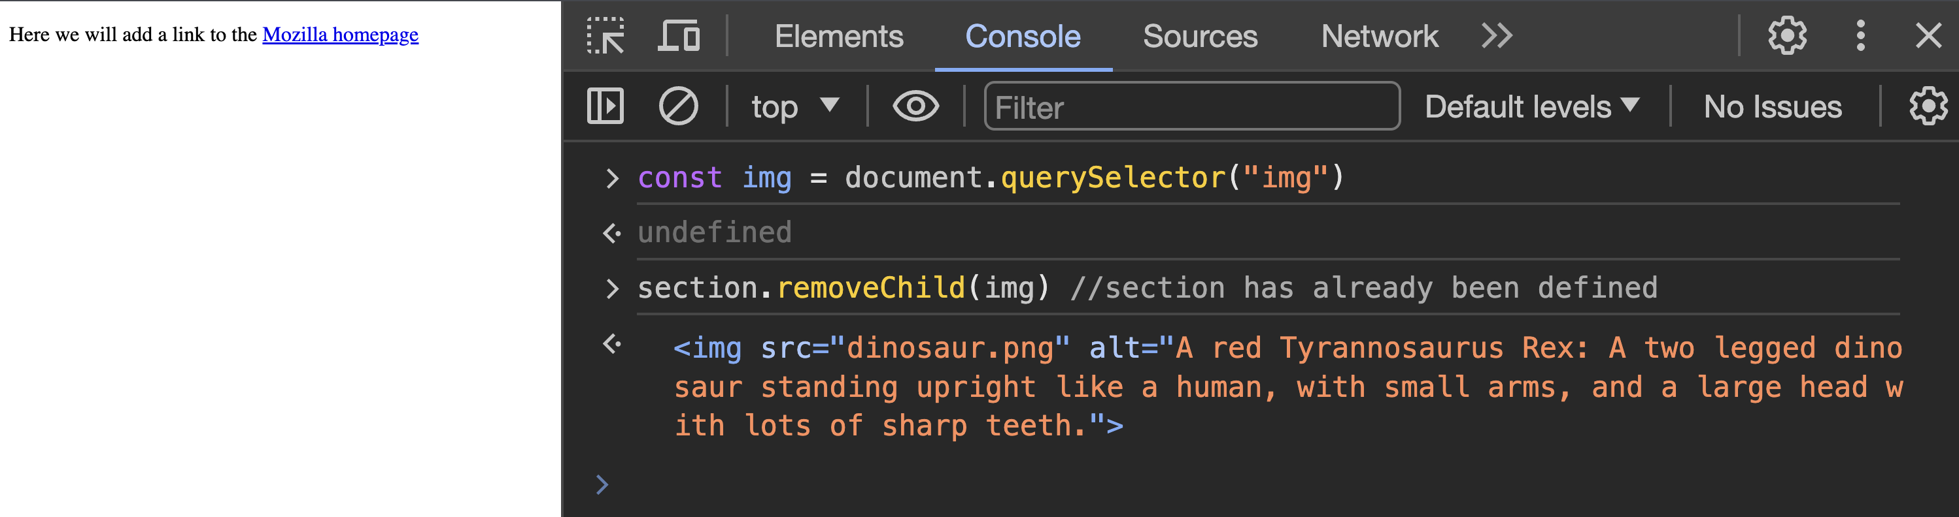

Slide 21

Recap
We used the console to interact with the “document”
We used “querySelector”, “querySelectorAll” and “getElementById”
Augmented a link element via “link.href = …….”
document.querySelector(“a”).href = “http://google.ie”
Used “document.createElement” to create an element
Used ”element.appendChild” to add an element to a section
Used “element.removeChild” to remove an img
Could also use “element.remove()” for the element to remove itself

Slide 22

So now we’ve seen how to manipulate the DOM
In theory, you could now start a webpage with just HTML and build it from the JavaScript Console
We’ve intentionally jumped straight into DOM manipulation while ignoring the semantics of JavaScript
Over the next few sessions, we will formally introduce JavaScript
For now, use the examples provided to get some comfort with the DOM

